Slide 1
Unit II Logical Reasoning
Agents that reason logically (logical agents)
Logic: A formal language to represent the knowledge in which reasoning is carried out to achieve the goal state through syntax and semantics are defined correctly is known as logic.
The syntax of a language describes how the sentences are represented inside the computer.
The semantics determines the facts in the world (ie) when a particular configuration exists within an agent, the agent believes in the world.
X=y , a valid statement--- syntax.
If the value of x and y matches then true else false – semantics.

Slide 2
We will represent the sentences using two different logics.
1. Propositional Logic or Boolean Logic
2. Predicate Logic or First Order Logic
Propositional Logic
Predicate Logic
(i) Each fact is represented by one symbol.
(i) Representation of world in terms of objects and predicates on objects (i.e, properties of objects or relations between objects)
(ii) Propositional symbols can be connected with Boolean connectives , to give more complex meaning. Connectives: ˄ ˅ ⌐ ⬄ =>
(ii) Connectives and quantifiers are used to represent the meaning of the sentence.
Connectives : ˄ ˅ ⌐ ⬄ =>
Quantifiers :
(iii) Simple statements are implemented.
(iii) Complex statements are implemented.
(iv) Example : Plato is a man.
PLATOMAN
(iv) Example : Plato is a man.
MAN (PLATO)

Slide 3
Knowledge engineering in first order logic:
A knowledge engineer is someone who investigates a particular domain, learns what concepts are important in that domain, and creates a formal representation of the objects and relations in the domain.
The knowledge engineering process
Knowledge engineering projects vary widely in content, scope, and difficulty, but all such projects include the following steps:
Identify the task.
Assemble the relevant knowledge.
Decide on a vocabulary of predicates, functions, and (constants.
Encode general /knowledge about the domain.
Encode a description of the specific problem instance.
Pose queries to the inference procedure and get answers.
Debug the knowledge base.

Slide 4
Identify the task. The knowledge engineer must delineate the range of questions that the knowledge base will support and the kinds of facts that will be available for each specific problem instance.
Assemble the relevant knowledge. The knowledge engineer might already be an expert in the domain, or might need to work with real experts to extract what they know-a process called knowledge acquisition.
At this stage, the knowledge is not represented formally. The idea is to understand the scope of the knowledge base, as determined by the task, and to understand how the domain actually works.
Decide on a vocabulary of predicates, functions, and (constants. That is, translate the important domain-level concepts into logic-level names. This involves many questions of knowledge engineering style.

Slide 5
Encode general /knowledge about the domain. The knowledge engineer writes down the axioms for all the vocabulary terms. This pins down (to the extent possible) the meaning of the terms, enabling the expert to check the content.
Encode a description of the specific problem instance. If the ontology is well thought out, this step will be easy. It will involve writing simple atomic sentences about instances of concepts that are already part of the ontology.
Pose queries to the inference procedure and get answers. This is where the reward is: we can let the inference procedure operate on the axioms and problem-specific facts to derive the facts we are interested in knowing.
Debug the knowledge base. Alas, the answers to queries will seldom be correct on the first try. More precisely, the answers will be correct for the knowledge base as written, assuming that the inference procedure is sound, but they will not be the ones that the user is expecting.

Slide 6
1. Identify the task
Analyze the circuit functionality , does the circuit actually add properly ? ( circuit verification)

Slide 7
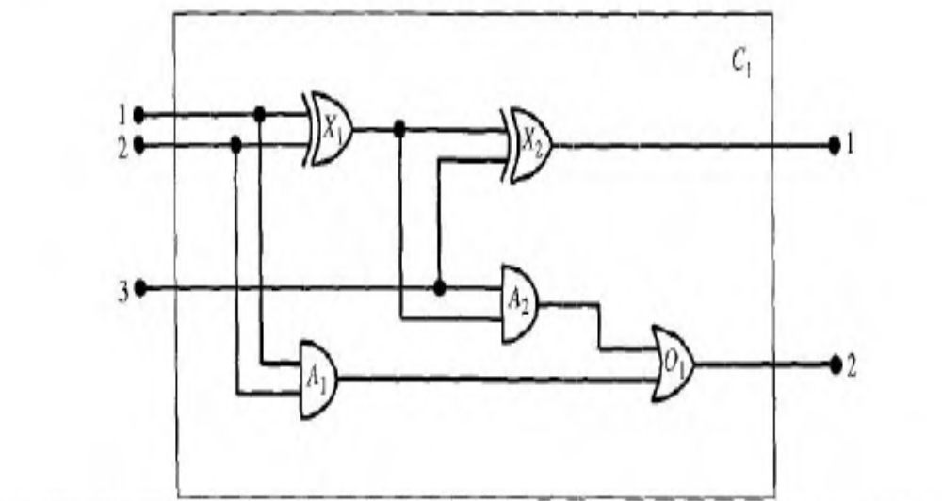
A digital circuit C1, purporting to be a one-bit. full adder. The first two inputs are the two bits to be added and the third input is a carry bit.
The first output is the sum, and the second output is a carry bit for the next adder.
The circuit contains two XOR gates, two AND gates and one OR gate.

Slide 8
2. Assemble the relevant knowledge
The circuit is composed of wires and gates.
The four types of gates ( AND, OR, XOR, NOT) with two input terminals and one output terminal knowledge is collected.

Slide 9
3. Decide on a vocabulary
we can write Type(X₁)= XOR. This introduces the constant XOR for a particular type of gate; the other constants will be called OR, AND, and NOT.
The Type function is not the only way to encode the ontological distinction. We could have used a binary predicate, Type(X₁ XOR), or several individual type predicates, such as XOR(X₁)
A gate or circuit can have one or more input terminals and one or more output terminals. Thus, gate X₁ could have terminals named X_{I} In₁ X_{I} In₂, and X_{I} Out₁.
The connectivity between gates can be represented by the predicate Connected, which takes two terminals as arguments, as in Connected (Out(1, X_{I}), In(1, X₂)).

Slide 10
4. Encode general knowledge of the domain
We need only seven simple rules to describe everything we need to know about circuits:
If two terminals are connected, then they have the same signal:
The signal at every terminal is either 1 or 0 (but not both):
Connected is a commutative predicate:
An OR gate's output is 1 if and only if any of its inputs is 1:
An AND gate's output is 0 if and only if any of its inputs is 0:
An XOR gate's output is 1 if and only if its inputs are different:
A NOT gate's output is different from its input:

Slide 11
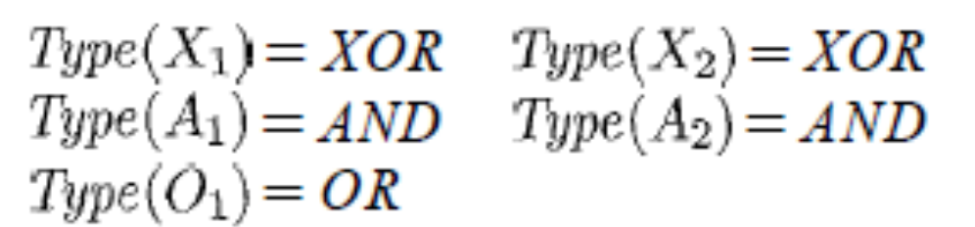
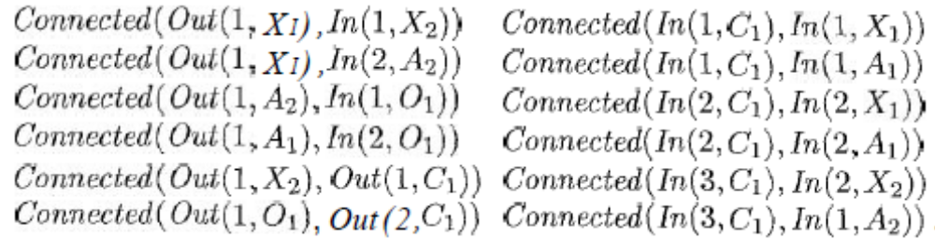
5. Encode the specific problem instance
The circuit shown in Figure is encoded as circuit C1 with the following description. First, we categorize the gates:
Then, we show the connections between them:

Slide 12
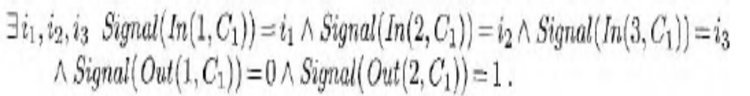
6. Pose queries to the inference procedure
What combinations of inputs would cause the first output of C_{l} (the sum bit) to be 0 and the second output of C₁ (the carry bit) to be 1?
The answers are substitutions for the variables i_{l}, i₂, and i₃ such that the resulting sentence is entailed by the knowledge base. There are three such substitutions:

Slide 13
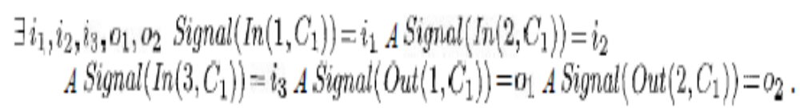
What are the possible sets of values of all the terminals for the adder circuit?
This final query will return a complete input-output table for the device, which can be used to check that it does in fact add its inputs correctly. This is a simple example of circuit verification.

Slide 14
7. Debug the knowledge base
We can perturb the knowledge base in various ways to see what kinds of erroneous behaviours emerge.
For example, suppose we omit the assertion that 1 ≠ 0 ^{12.}
Suddenly, the system will be unable to prove any outputs for the circuit, except for the input cases 000 and 110.
We can pinpoint the problem by asking for the outputs of each gate.

Slide 15

For example, we can ask
which reveals that no outputs are known at X_{I} for the input cases 10 and 01.
Then, we look at the axiom for XOR gates, as applied to X_{I} :
If the inputs are known to be, say, 1 and 0, then this reduces to
Now the problem is apparent: the system is unable to infer that so we must need to tell it that 1 ≠ 0 in the KB.

